Slide 1

Testing scientific code Because you’re worth it
Lisa Schwetlick and Pamela Hathway
Notes:
materials by Pietro

Slide 2

You, as the Master of Research
You start a new project, let’s say with a new simulation method or a new dataset and have a few ideas for possible analyses.
You implement the analyses as prototypes; once each prototype is finished, you can confidently decide whether it is is a dead end, or worth pursuing.
Once you find an idea on which it is worth spending energy, you take the prototype and easily re-organize and optimize it so that it scales up to the full size of your problem.
As expected, the scaled-up experiment delivers good results, and your next paper is under way.
August 2023, CC BY-SA 4.0
Testing scientific code, v16.0

Slide 3

How to reach enlightenment
How do we get to the blessed state of confidence and efficiency?
Being a Python expert is not sufficient, good programming practices make a big difference
We can learn a lot from the development methods developed for commercial and open source software
August 2023, CC BY-SA 4.0
Testing scientific code, v16.0
Notes:
How do we reach this dream state where we are so efficient to just write code and re-use it without problem, and we are confident that it gives the correct result.
Being good at Python is one thing, but there are also general programming behaviours that can help you and in this lecture we will go over a few of them.

Slide 4
Outline
The agile programming cycle
Testing scientific code basics
Testing patterns for scientific code
Debugging
Continuous Integration
August 2023, CC BY-SA 4.0
Testing scientific code, v16.0

Slide 5
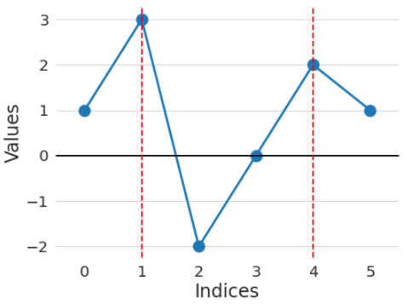
Warm-up project
Go to the directory called hands_on/local_maxima
In the file called local_maxima.py, write a function find_maxima that finds the indices of local maxima in a list of numbers
For example, find_maxima([1, 3, -2, 0, 2, 1]) should return [1, 4]
August 2023, CC BY-SA 4.0
Testing scientific code, v16.0
Notes:
At end of exercise: Show of hands, who is confident in their solution

Slide 6
Warm-up project
Write a function find_maxima that finds the indices of local maxima in a list of numbers
Check your solution with these inputs:
Input: [1, 3, -2, 0, 2, 1] Expected result: [1, 4]
Input: [4, 2, 1, 3, 1, 5] Expected result: [0, 3, 5]
Input: [] Expected result: []
Input: [1, 2, 2, 1] Expected result: [1] (or [2], or [1, 2])
Input: [1, 2, 2, 3, 1] Expected result: [3]
August 2023, CC BY-SA 4.0
Testing scientific code, v16.0

Slide 7
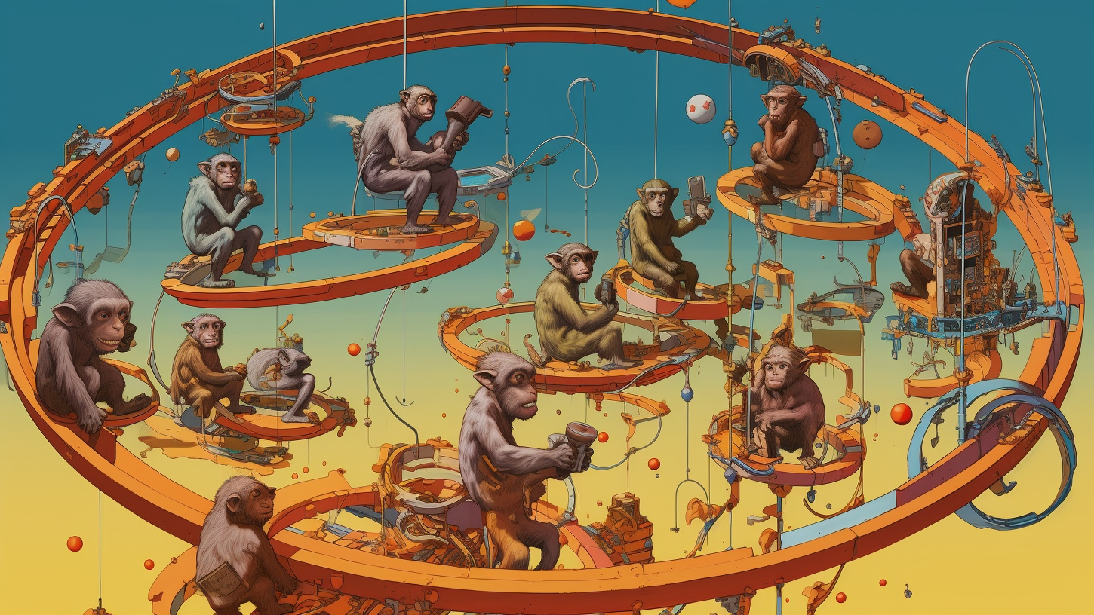
The agile programming cycle
August 2023, CC BY-SA 4.0
Testing scientific code, v16.0
Notes:
This was interesting, right? Your solution worked for some cases but not in others.
Scientists are not the only ones who have to check that their code is working correctly or as expected. This is a main component of software engineering.
Let’s talk about how we programme in a software development environment and why adopting some of these practices can be really beneficial for scientific research.

Slide 8
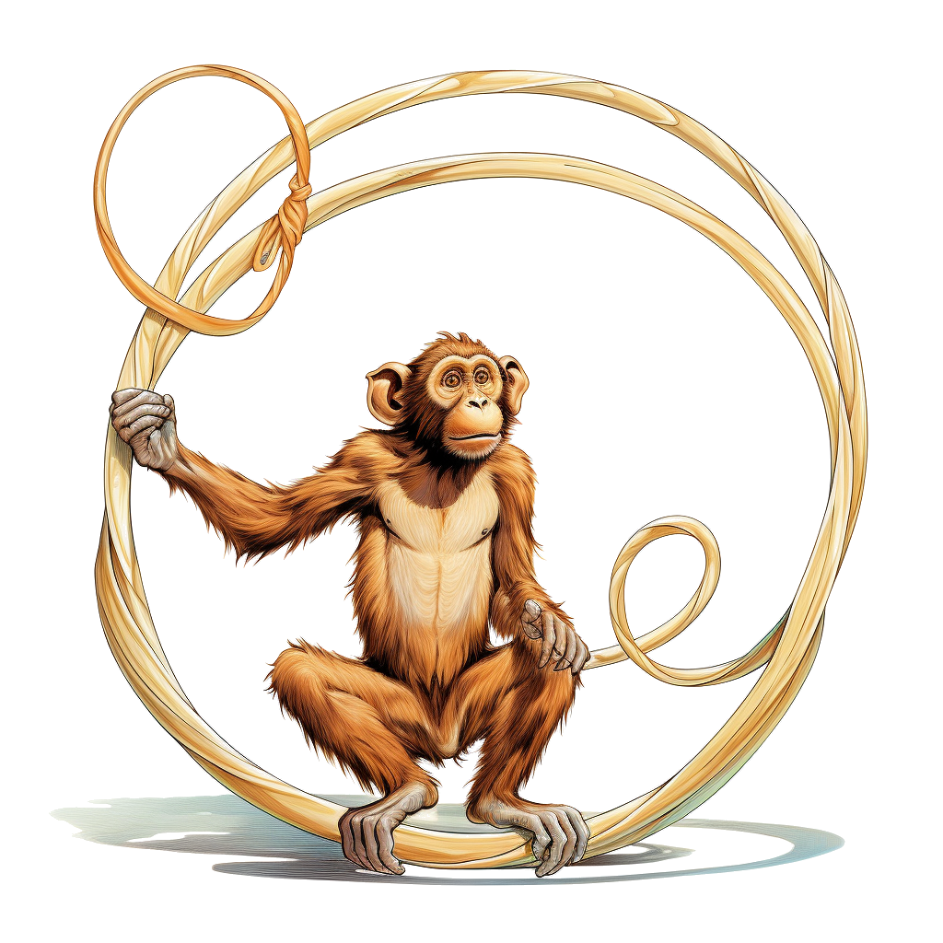
The agile development cycle
Pick your next feature
Write tests to check that feature works
Write simplest code that makes tests pass
Run tests and debug until all tests pass
Refactor and optimize only if necessary
August 2023, CC BY-SA 4.0
Testing scientific code, v16.0
Notes:
As opposed to waterfall model
Reminder
1) describe cycle
2) short development cycles: granularity of chosen feature is important
3) for all of these steps there are python tools to help you
======
Actually maybe it's better to show test and debug cycle?

Slide 9
Python tools for agile development
Pick your next feature
Write tests to check that feature works
pytest
Write simplest code that makes tests pass
Run tests and debug until all tests pass
pdb
timeit
cProfile
line_profiler
Refactor and optimize only if necessary
August 2023, CC BY-SA 4.0
Testing scientific code, v16.0
Notes:
3) for all of these steps there are python tools to help you

Slide 10

Why test scientific code?
August 2023, CC BY-SA 4.0
Testing scientific code, v16.0
Notes:
Show of hands, who is absolutely confident that the code they have written for their research is completely correct and has no bugs.

Slide 11
Why write tests at all?
Confidence while re-using code:
Write the code once and use it confidently everywhere else: avoid the negative result effect!
Confidence while editing code:
When you have tests, you can change any part of your code and you will be confident that you have not changed the result
change any line in the code
Refactor to improve readability/speed/memory usage
Confidence in correctness:
Correctness is main requirement for scientific code
You must have a strategy to ensure correctness
August 2023, CC BY-SA 4.0
Testing scientific code, v16.0
Notes:
2) insert example from yesterday / today morning
3) Even if you never work with anyone else, write all your code into one jupyter notebook that noone ever edits, then you still would like to be sure that it actually does what it does
[… slide …]
If we think about correctness in computational science - there is incorrect and there is INCORRECT

Slide 12
Effect of software bugs in science
frequency
bug severity
oops, wrong labels!
need to send errata corrige
end of career
August 2023, CC BY-SA 4.0
Testing scientific code, v16.0
Notes:
Made up plot, not backed by any data; and no error bars!
This slide is supposed to scare you into listening to the rest

Slide 13
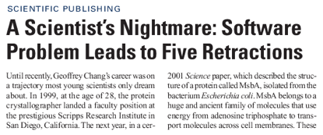
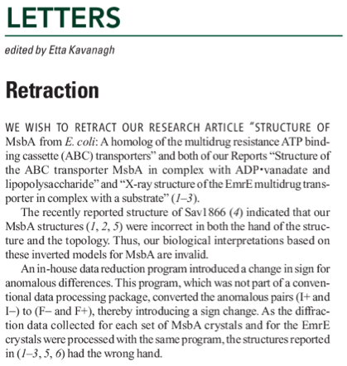
The unfortunate story of Geoffrey Chang
Science, Dec 2006: 5 high-profile retractions (3x Science, PNAS, J. Mol. Biol.) because ”an in-house data reduction program introduced a change in sign for anomalous differences”
August 2023, CC BY-SA 4.0
Testing scientific code, v16.0
Notes:
When you get a crappy result, you triple check your code for bugs. If the results come out just the way you want them to, how much effort are you going to put into double-checking?
For two errors reported and retraced, many more undetected or not reported.

Slide 14
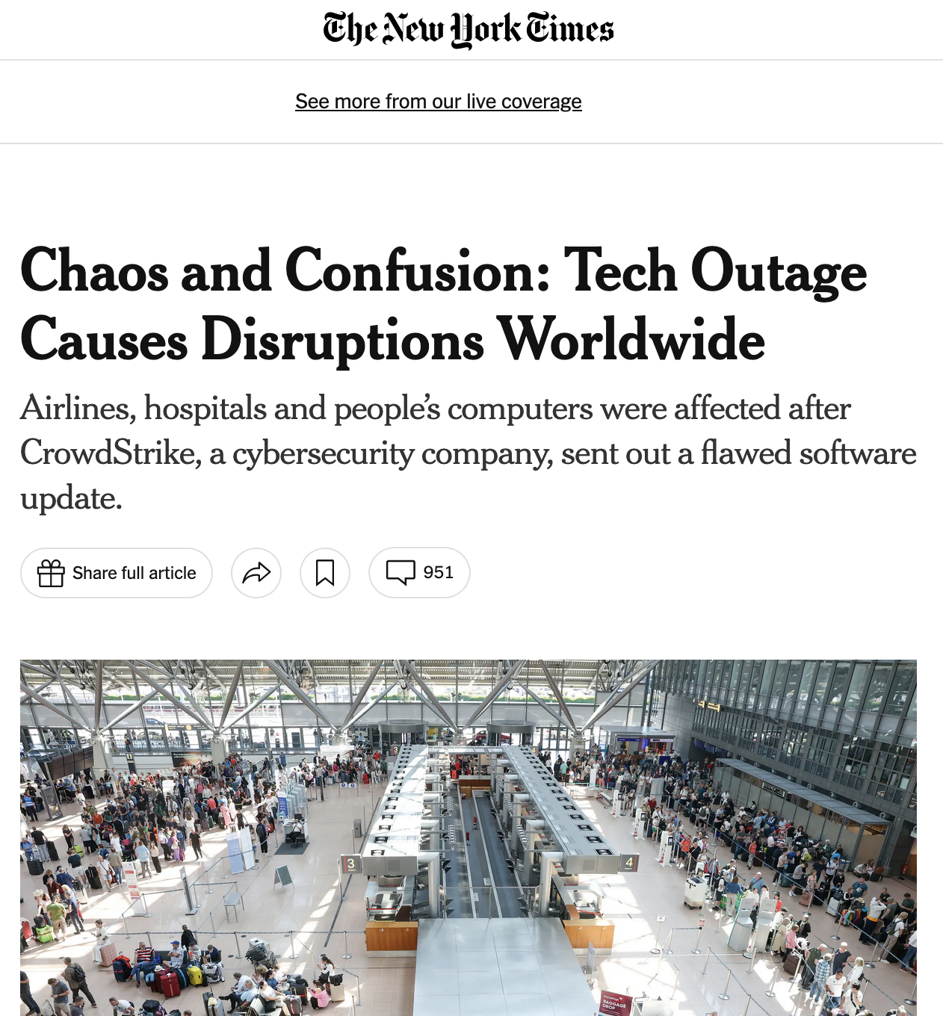
2024 CrowdStrike incident
A software update by CrowdStrike resulted in 8.5 million Microsoft Windows-based systems crashing, unable to restart (across hospitals, airports, companies, …)
—> largest outage in the history of information technology
They changed one array from 20 entries to 21 entries, which caused a fatal error.
They did not test this change properly:
their unit tests only tested the most basic case (happy path)
their manual test only tested valid data
August 2023, CC BY-SA 4.0
Testing scientific code, v16.0
Notes:
tests were a bit like you only using the obvious array to test your find_maxima function, but not testing on an empty list or maxima at the ends etc.

Slide 15

Testing basics
August 2023, CC BY-SA 4.0
Testing scientific code, v16.0
Notes:
I hope I have given you enough motivation. So let‘s get into testing.

Slide 16
A test is just another function
Imagine we wrote this new function, and we wanted to test it
def times_3(x):
"""Multiply x by 3.
Parameters
----------
x : The item to multiply by 3.
"""
return x * 3
August 2023, CC BY-SA 4.0
Testing scientific code, v16.0
Notes:
DEMO
1. test manually: write result = times_3(2) into file and run it → correct result.
- write result = times_3(2) into file and run it → correct result.
- change 2 → “a” and run again
I just tested my function. Cool.
How can I improve this? NO CODING
keep both tests in file
write what the expected value is
if name == main
what if you write many more functions
You know what would be really cool?
If I could move all of this code somewhere else, into a different directory and be able to collect all of the test cases and be able to run them any time I want.
Tadaaa – this is where we get to Pytest, which enables us to do all of that.

Slide 17
Testing frameworks
The collection of tests written to test a package is called a “test suite”
Execution of a test suite is automated: external software runs the tests and provides reports and statistics
Main testing frameworks for python:
unittest: in the standard library
pytest: what is most commonly used
=============================================== test session starts ================================================
platform darwin -- Python 3.11.3, pytest-7.3.1, pluggy-1.0.0
collected 2 items
test_first.py::test_times_3_integer PASSED [ 50%]
test_first.py::test_times_3_string PASSED [100%]
================================================ 2 passed in 0.00s =================================================
August 2023, CC BY-SA 4.0
Testing scientific code, v16.0
Notes:
Pytest is a testing framework for Python.
It collects all of your tests and runs them for you and tells you whether they passed or failed.

Slide 18
Hands-on!
Go to hands_on/first
Discover all tests in all subdirectories pytest –v
Execute all tests in one module pytest -v test_first.py
Execute one single test pytest -v test_first.py::test_times_3_string
Look into test_first.py. What do you see?
August 2023, CC BY-SA 4.0
Testing scientific code, v16.0
Notes:
After exercise: Ask what they saw in the test file.
test file name
tests names
assertions
structure of tests – setup, expected, result, assertion

Slide 19
Test suites in Python with pytest
Writing tests with pytest is simple:
Tests are collected in files called test_abc.py , which usually contains tests for the functions defined in a corresponding module abc
Each test is a function called test_jkl_feature, and usually it tests feature feature of a function called jkl
Each test tests one feature in your code, and checks that it behaves correctly using “assertions”. An exception is raised if it does not work as expected.
August 2023, CC BY-SA 4.0
Testing scientific code, v16.0
Notes:
[… slide …]
The one thing you may be unfamiliar with are assertions, so let‘s atlk about them a bit.

Slide 20
Assertions
assert statements check that some condition is met, and raise an exception otherwise
Check that statement is true/false: assert 'Hi'.islower() => fail assert not 'Hi'.islower() => pass
Check that two objects are equal: assert 2 + 1 == 3 => pass assert [2] + [1] == [2, 1] => pass assert 'a' + 'b' != 'ab' => fail
assert can be used to compare all sorts of objects, and pytest will take care of producing an appropriate error message
August 2023, CC BY-SA 4.0
Testing scientific code, v16.0

Slide 21
Hands-on! Possibly your first test
Inside test_first.py, test that times_3([1]) returns what you would expect
Try to change the expected result in the test to [2] (or anything you want) and watch the test break. Look at the error message and make sure you understand what’s going on
August 2023, CC BY-SA 4.0
Testing scientific code, v16.0

Slide 22
Hands-on!
Create a new file, test_plus.py: write a test that asserts that 1+2 is 3
Execute the test
August 2023, CC BY-SA 4.0
Testing scientific code, v16.0
Notes:
Write the test, it does not have to call a function, it can just assert that 1 + 2 == 3
What do you expect to happen, will the test pass or fail (show of hands)

Slide 23
Hands-on!
Create a new file, test_plus.py: write a test that asserts that 1+2 is 3
Execute the test
Then write a new test and assert that 1.1 + 2.2 is 3.3
Execute the tests
August 2023, CC BY-SA 4.0
Testing scientific code, v16.0
Notes:
Next one
What do you expect to happen, will the test pass or fail (show of hands)
Afterwards:
Did anyone find out why this fails?
DEMO:
terminal: evaluate 3.3, then evaluate 1.1 + 2.2 → 3.300000003

Slide 24
Floating point equality
Real numbers are represented approximately as “floating point” numbers. When developing numerical code, we have to allow for approximation errors.
Check that two numbers are approximately equal: from math import isclose def test_floating_point_math(): assert isclose(1.1 + 2.2, 3.3) => pass
abs_tol controls the absolute tolerance: assert isclose(1.121, 1.2, abs_tol=0.1) => pass assert isclose(1.121, 1.2, abs_tol=0.01) => fail
rel_tol controls the relative tolerance: assert isclose(120.1, 121.4, rel_tol=0.1) => pass assert isclose(120.4, 121.4, rel_tol=0.01) => fail
August 2023, CC BY-SA 4.0
Testing scientific code, v16.0
Notes:
If you’re working with floating point numbers two number are rarely exactly the same
DEMO
show that isclose works.

Slide 25
Hands-on!
One more equality test: check that the sum of these two NumPy arrays: x = np.array([1, 1]) y = np.array([2, 2]) is equal to z = np.array([3, 3])
August 2023, CC BY-SA 4.0
Testing scientific code, v16.0
Notes:
Show of hands, who thinks this will work?

Slide 26
Testing with numpy arrays
def test_numpy_equality(): x = np.array([1, 1]) y = np.array([2, 2]) z = np.array([3, 3]) assert x + y == z
__________________________________ test_numpy_equality __________________________________
def test_numpy_equality():
x = numpy.array([1, 1])
y = numpy.array([2, 2])
z = numpy.array([3, 3])
> assert x + y == z
E ValueError: The truth value of an array with more than one element is ambiguous. Use a.any() or a.all()
code.py:47: ValueError
August 2023, CC BY-SA 4.0
Testing scientific code, v16.0
Notes:
The intention was to test for equality element-by-element

Slide 27
Testing with numpy arrays
The module np.testing defines helper functions: assert_equal(x, y) assert_allclose(x, y, rtol=1e-07, atol=0)
If you need to check more complex conditions:
np.all(x): returns True if all elements of x are true np.any(x): returns True is any of the elements of x is true
combine with logical_and, logical_or, logical_not: # test that all elements of x are between 0 and 1 assert all(logical_and(x > 0.0, x < 1.0))
August 2023, CC BY-SA 4.0
Testing scientific code, v16.0
Notes:
To get the element-by-element check we want, we need to be more specific
DEMO that assert_equal works here as well
If you need to check more complex conditions, you can combine stuff
Just to show you all and any
DEMO python in terminal
import numpy as np
a = np.array([1, 2, 3])
assert np.all(a > 1)
assert np.all(a >= 1)
assert np.any(a > 1)
a > 1
a >= 1
allclose:
The tolerance values are positive, typically very small numbers. The
relative difference (`rtol` * abs(`b`)) and the absolute difference
`atol` are added together to compare against the absolute difference
between `a` and `b`.

Slide 28
Watch out for nans!
In general, nan is not equal to itself (IEEE standard)
assert_equal and assert_allclose consider nans equal by default
In [2]: np.nan == np.nan
Out[2]: False
def test_allclose_with_nan():
x = np.array([1.1, np.nan])
y = np.array([2.2, np.nan])
z = np.array([3.3, np.nan])
assert_allclose(x + y, z)
test_numpy_equality.py::test_allclose_with_nan PASSED
August 2023, CC BY-SA 4.0
Testing scientific code, v16.0

Slide 29
Write a working version of find_maxima, with testing
Read carefully the description of Issue #1 on GitHub
Submit a Pull Request for Issue #1
Fork the repository (if you haven’t already)
Create a new branch on the fork called e.g. fix-1
Solve the issue with one or more commits
Push the branch to your GitHub fork
On GitHub, go to “Pull Requests” and open a pull request against branch main of the official ASPP repository
In the PR description write “Fixes #1” somewhere, this is going to create an automatic link to the issue, and close the issue if the PR is merged
August 2023, CC BY-SA 4.0
Testing scientific code, v16.0

Slide 30

Up next: Testing patterns
August 2023, CC BY-SA 4.0
Testing scientific code, v16.0

Slide 31
August 2023, CC BY-SA 4.0
Testing scientific code, v16.0

Slide 32
Timings: 4,5 h
Part 1: 1,25
Part 2: 2,25
Debugging: 0,75
CI: 0,25
August 2023, CC BY-SA 4.0
Testing scientific code, v16.0

Slide 33
The agile development cycle
Pick your next feature
Write tests to check that feature works
debug
Write simplest code that makes tests pass
Run tests until all tests pass
Refactor + optimize only if necessary
August 2023, CC BY-SA 4.0
Testing scientific code, v16.0
Notes:
As opposed to waterfall model
Reminder
1) describe cycle
2) short development cycles: granularity of chosen feature is important
3) for all of these steps there are python tools to help you
======
Actually maybe it's better to show test and debug cycle?

Slide 34

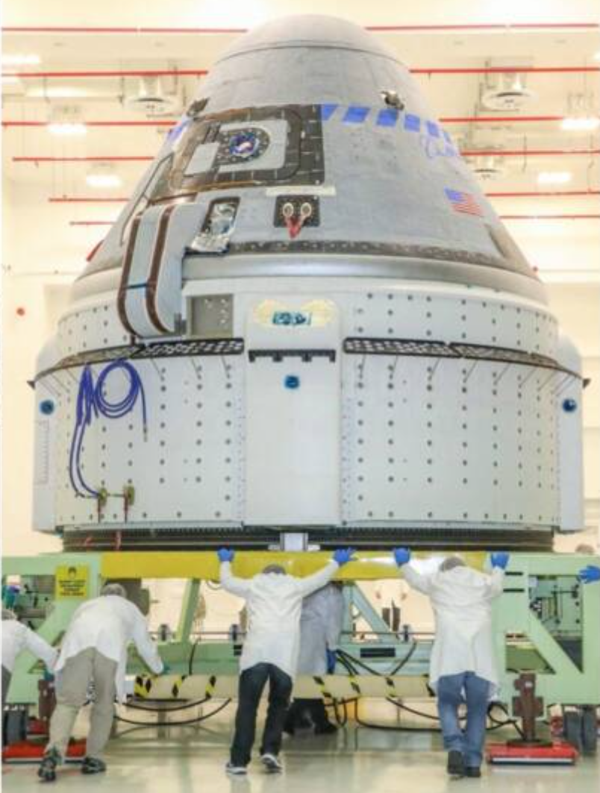
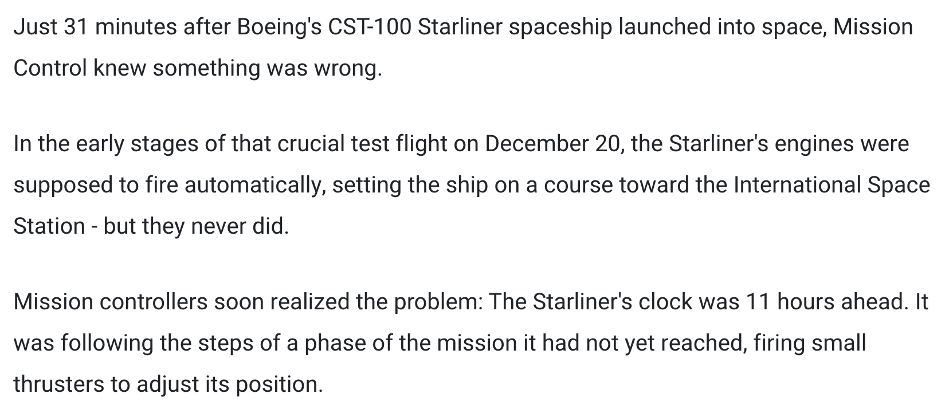
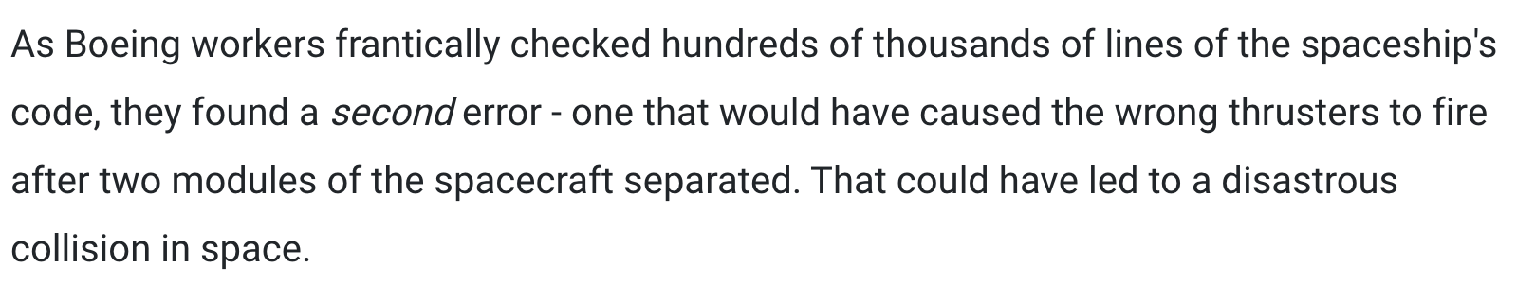
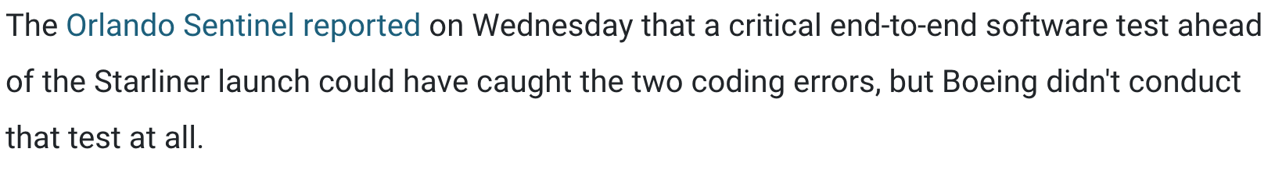
[...]
August 2023, CC BY-SA 4.0
Testing scientific code, v16.0
https://www.businessinsider.fr/us/boeing-software-errors-jeopardized-starliner-spaceship-737-max-planes-2020-2

Slide 35
Testing error control
Check that an exception is raised: from py.test import raises def test_raises(): with raises(SomeException): do_something() do_something_else()
For example: with raises(ValueError): int('XYZ’) passes, because int('XYZ’) ValueError: invalid literal for int() with base 10: 'XYZ'
August 2023, CC BY-SA 4.0
Testing scientific code, v16.0
Notes:
Finally

Slide 36
Testing error control
Use the most specific exception class, or the test may pass because of collateral damage: # Test that file "None" cannot be opened. with raises(IOError): open(None, 'r') as expected, but with raises(Exception): open(None, 'r’)
=> fail
=> pass
August 2023, CC BY-SA 4.0
Testing scientific code, v16.0

